Slide 1
The Grassland Plant Survey

Slide 2
Key vocabulary
Habitat | The place where an animal, plant or other organism lives
Quadrat | A frame which gives us our area to survey
Indicator plant | A plant that tells us information about its environment depending on whether we find it or not
Calcareous grassland | Grassland growing on alkaline soils derived from limestone or chalk bedrock

Slide 3
Why do we survey the plants in a habitat?

Slide 4
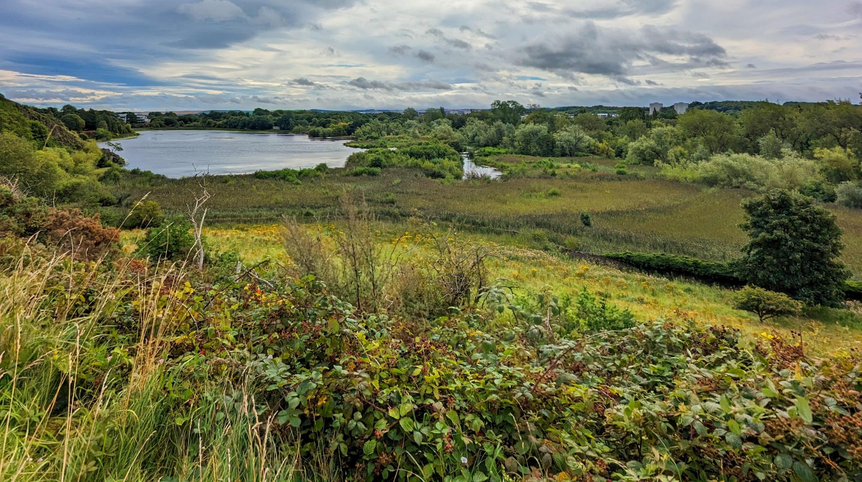
Divide this image into different habitats

Slide 5
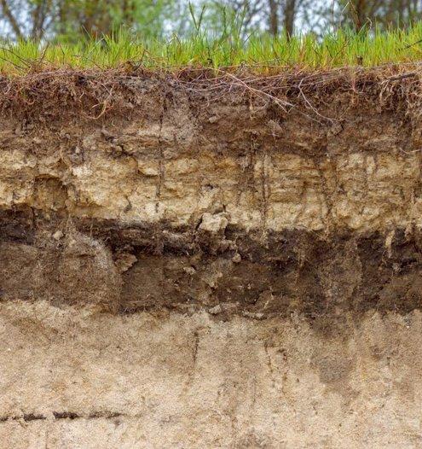
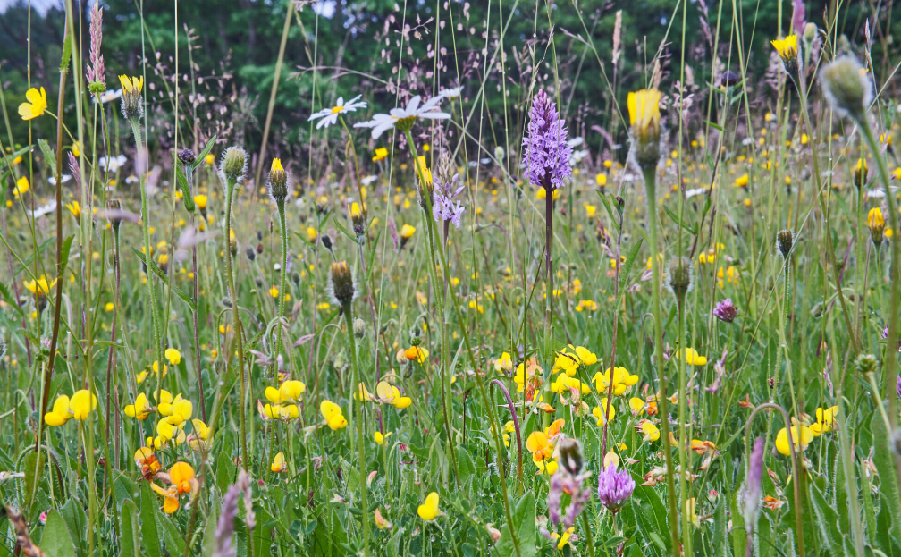
What factors did you use to differentiate habitats?
Plants can be used to tell us a lot about an ecosystem such as:
soil qualities biodiversity

Slide 6
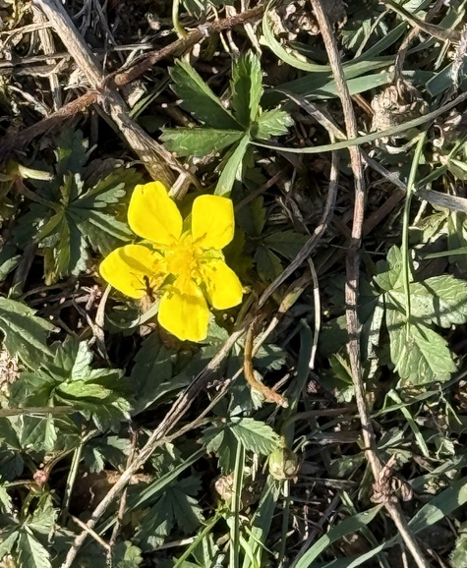
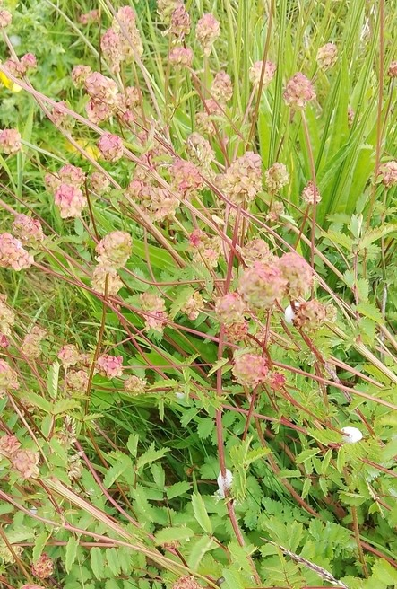
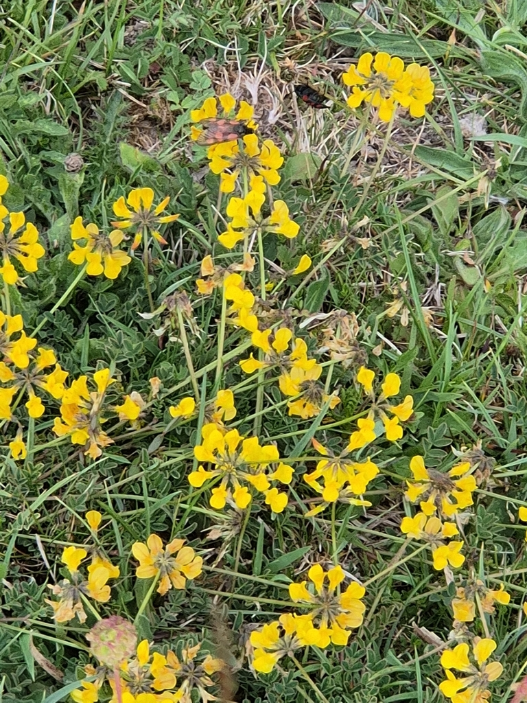
Example
Plants
indicate calcareous grassland,
an uncommon habitat that is home to many specialist animals.
cinquefoils
salad burnet
horseshoe vetch
Notes:
Calcareous grassland forms on top of chalk.
Soils tend to be thin and quick-draining, but the soil chemistry and structure support a variety of specialist plants.
Chalk dissolves relatively easily, so mineral nutrients are rapidly replenished.
Home to many snail species, including many which do not live in other habitats because there is not enough available calcium.
Also home to the Adonis blue butterfly, which relies on horseshoe vetch as a food plant. Horseshoe vetch needs chalk or limestone-based soils to grow well.

Slide 7
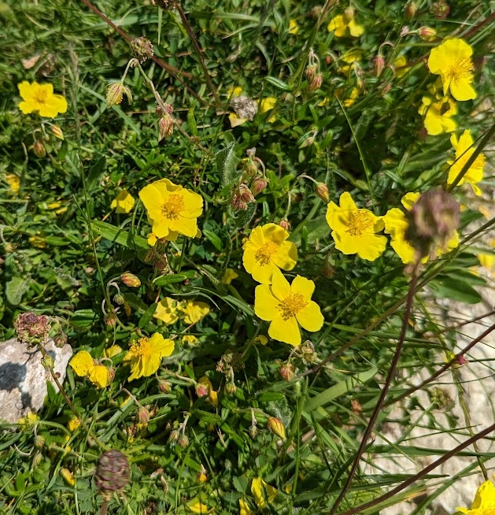
Notes:
Here are all three plants in the same picture

Slide 8
The Grassland Plant Survey

Slide 9
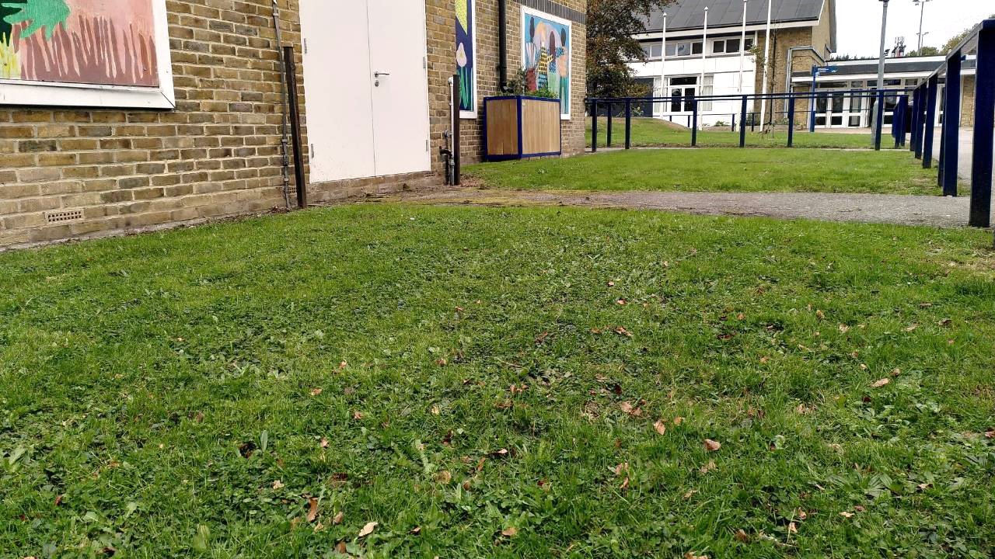
Are all grass habitats the same?

Slide 10
What types of grassland do we have here?
We need to survey what plants are growing in the grass.

Slide 11
Why are we looking at grass at school?
Dr Victoria Burton, a researcher working on Nature Park, says,
"Grasslands are the largest green habitat on most school grounds, but they don’t all support the same variety of plants. A playing field or lawn might have just one species per square metre, while a meadow can have more than fifteen. By looking closely, you can uncover what’s growing in your own grasslands and spot how it’s changing over time."

Slide 12
A team effort
schools up and down the country can all get involved in the same survey that we are doing
everyone is working together to learn about the state of grassy areas in schools across the country
this means we can learn how much biodiversity grassy areas in schools are supporting
we are all community scientists by getting involved!!

Slide 13

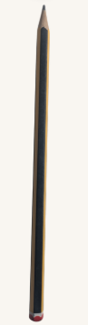

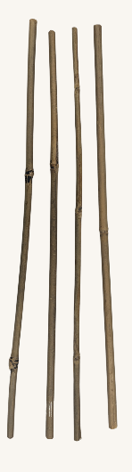
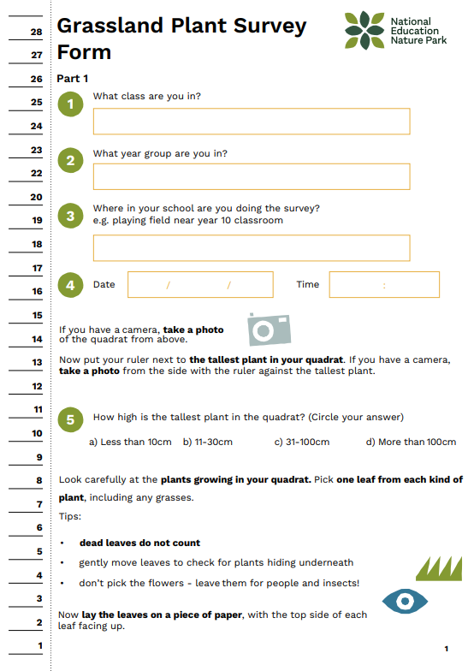
Equipment
tools for making 50cm x 50cm quadrat
clipboard pencil survey form blank paper

Slide 14
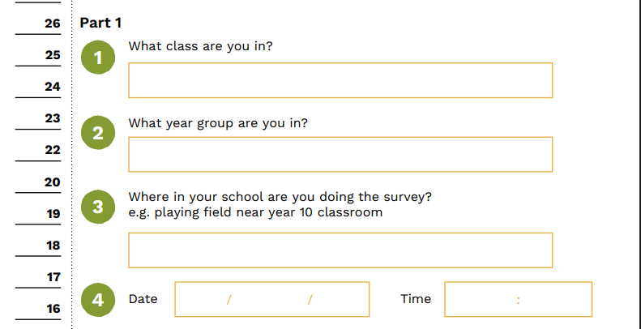
Part 1 of the survey
You will write down:
your class and year group
where in school you are doing the survey
the date and time
Notes:
Discuss part 1 of the survey.
Part 1 continues on the next slides

Slide 15
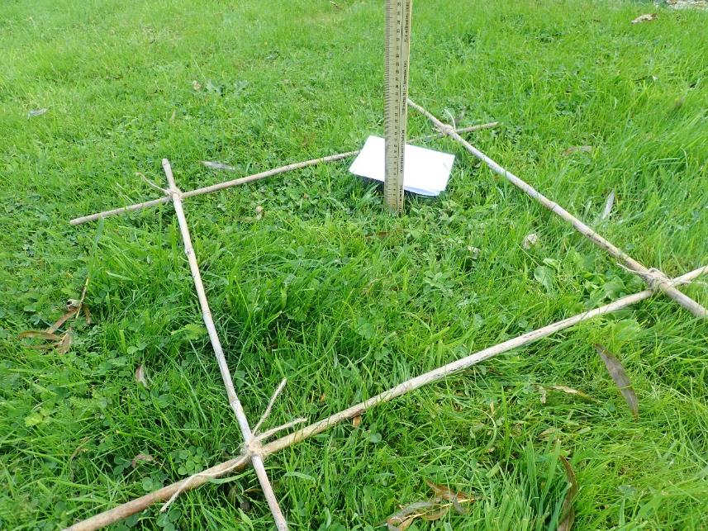
You will then:
take a photo of your quadrat from above and from the side
measure the height of the tallest plant in your quadrat
Notes:
The photos are not required so if you don't have a camera then you can remove that sentence from the slide. In the survey form it ask you to take a photo only if you have a camera.

Slide 16
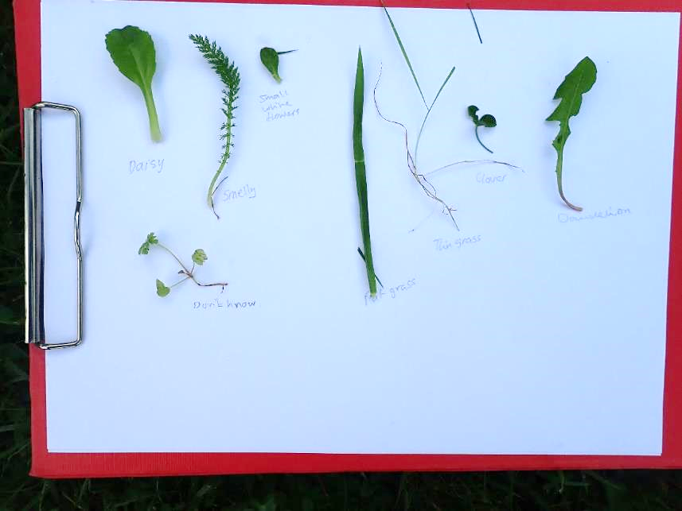
You will then:
count how many different types of plant are living inside your quadrat
pick a leaf from each type of living plant. Put them on a piece of paper and take a photo.
Dead leaves do not count!

Slide 17
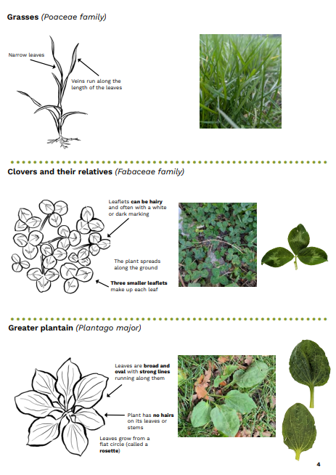
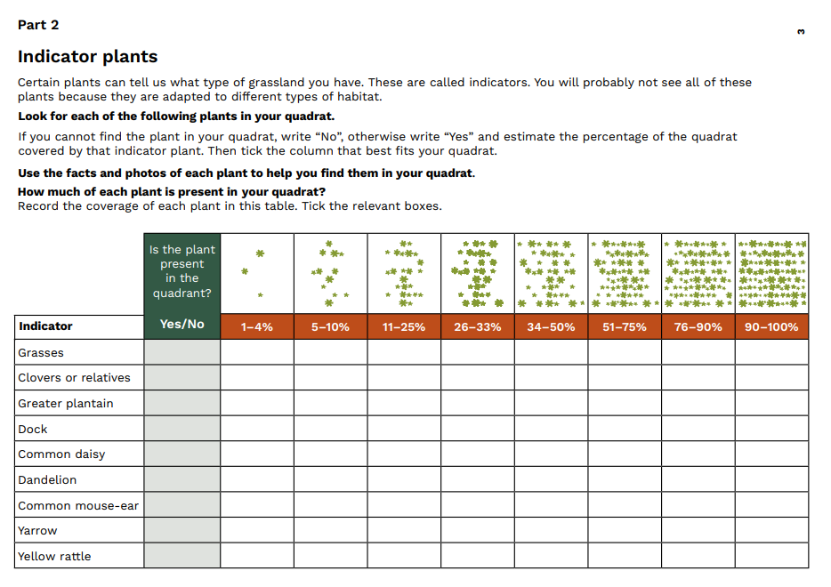
Part 2
You will:
look for different indicator plants inside your quadrat
for each indicator, write whether you find them in your quadrat or not
for each one you find write the percentage of the space inside the quadrat that it covers
Notes:
Remind them that it is not about finding all the indicators

Slide 18
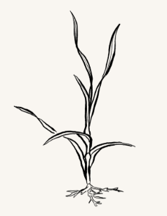
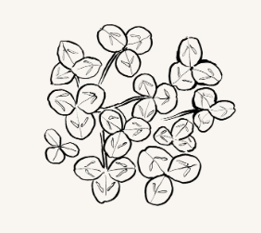
What indicator plants are we looking for?
Grass
Clovers and their relatives
Notes:
You could discuss for each indicator what features do they notice.
If you have given out the survey form already ask them to turn to part 2 and follow along with each plant in the survey form.

Slide 19

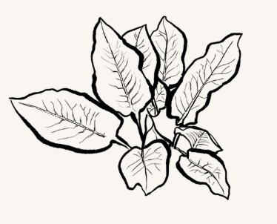
Greater plantain
Dock

Slide 20


Common daisy
Dandelion

Slide 21

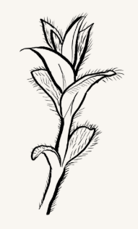
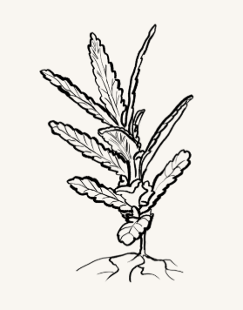
Common mouse-ear
Yarrow
Yellow rattle

Slide 22
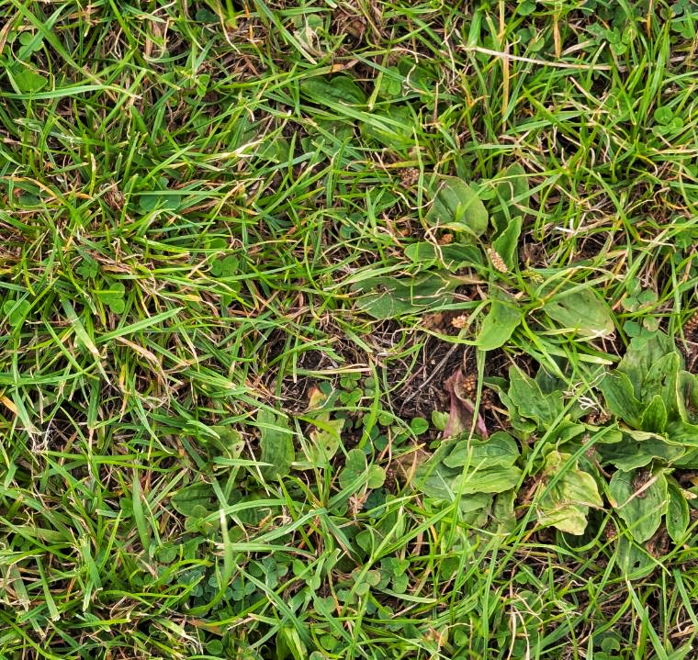
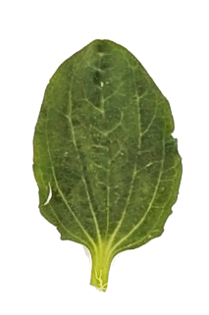
What percentage of this quadrat has greater plantain?

Slide 23
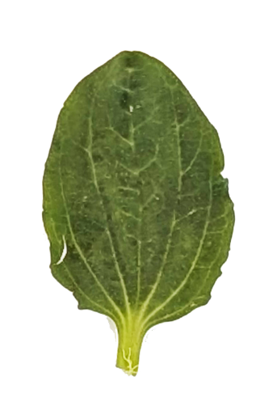
What percentage of this quadrat has greater plantain?

Slide 24

Just over one third (33%) of this square is covered in greater plantain.
This means Greater plantain would go in the 34-50% category.

Slide 25
When we come back inside
We will:
enter the results of our survey online on the Nature Park website
start to think about what our results mean
think about where else at school we could do this survey and different things we can investigate e.g. results before and after we let the grass in an area grow long

Slide 26
What happens with the data
we can use our results to find much more about grassy areas at school as we discussed earlier
it will be combined with all the other Grassland Plant Surveys carried out across England in other schools to answer questions about grasslands nationally
it will be made available to other schools and researchers who can study it and use it in their learning

